Slide 1
Learning Objective: To write a counter argument.
Steps to Success:
Be able to suggest a counter argument for a point of view.
Use appropriate vocabulary in a written counter argument.
To compose a paragraph including argument and counter argument.

Slide 2
What does Bias mean?
In your talk partners discuss and then write down on white boards what you already understand by this word.

Slide 3
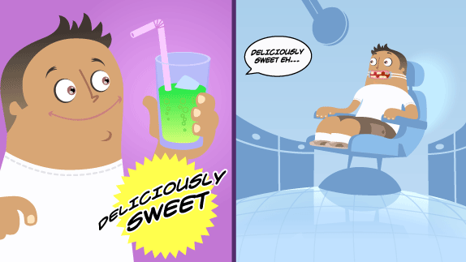
Bias
Bias
Bias means someone is only putting forward one side of an argument. An advert, for example, will only tell you the good things about a product, and may exaggerate those!

Slide 4
Visit the London Zoo
Please watch the London Zoo video and write down 4 important facts on your whiteboards.
Consider:
What is the purpose of the video?
Who is the audience it is aimed at?
Is it biased in any way?
http://www.bing.com/videos/search?q=youtube+zsl+zoo+advert&qpvt=u+tube+zsl+zoo+advert&FORM=VDRE&adlt=strict&ajf=70#view=detail&mid=AD46FC8AD7EE292C811CAD46FC8AD7EE292C811C

